Slide 1
Management of Hematuria in Children
가톨릭의대
손 동 완

Slide 2
A suggested approach for referral of a child with hematuria
Urologist)
- Reassurance
- Abnormal genitourinary anatomy
- Trauma
- Stones (nephrologist for metabolic work-up)
- Tumor
- Nonglomerular gross hematuria

Slide 3
A suggested approach for referral of a child with hematuria
Nephrologist)
- Acute poststreptococcal glomerulonephritis (PSGN)
c hypertension, azotemia or Hyperkalemia
- Other forms of glomerulonephritis (particulary c
proteinuria, hypertension, persistent
hypocomplementemia)
- Family history of renal failure
- Systemic disease

Slide 4
Clinical Categories
gross hematuria
microscopic hematuria with clinical symptoms
asymptomatic isolated hematuria
asymptomatic hematuria with proteinuria

Slide 5
Gross hematuria

Slide 6
Etiology
relatively unusual (1 in 1000 pediatrics outpatient
clinic)
requires prompt evaluation to exclude potentially
life-threatening causes
hypercalciuria (m/c)
others; glomerular hematuria (PSGN, IgA nephropathy),
UTI, urinary stone, congenital anomalies, trauma
recurrent G. hematuria ; IgA nephropathy, hypercalciuria
Gross hematuria without proteinuria or RBC casts
: malignancy, cystic renal ds. → Sono. of KUB

Slide 7
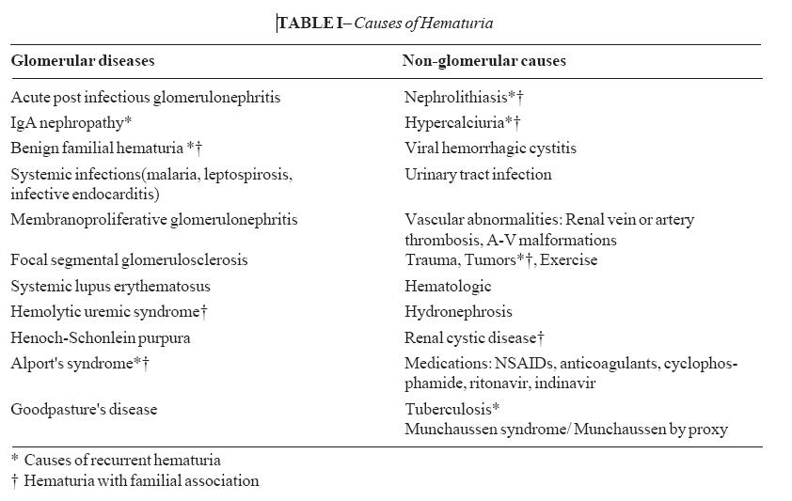
Glomerular origin vs non-glomerular origin

Slide 8
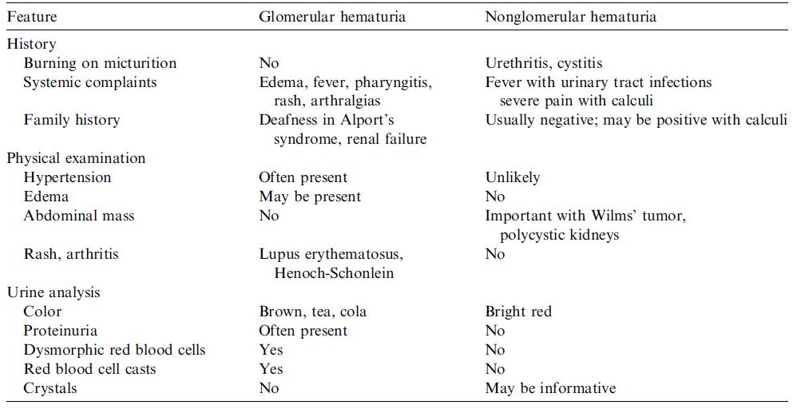
Distinguishing features of glomerular and non-glomerular hematuria

Slide 9
IgA nephropathy
most common glomerular hematuria
cause recurrent gross hematuira
in association with a respiratory tract infection or
pharyngitis
diagnosis – based on renal biopsy
crecentric GN. Older age onset, HT, proteinuria
treatment – no specific tx.
usually based on the severity of disease
ACE inhibitors or fish oil
Corticosteroids
Mycophenolate mofetil (recently)

Slide 10
Postinfectious glomerulonephritis (PIGN)
Postinfectious glomerulonephritis (PIGN)
sore throat or skin infection within the past 2~4 weeks
history of headache, vomiting, blurring of vision, altered
sensorium, seizures, breathless
diagnosis
- positive antistreptolysin-O or streptozyme titer
(often positive within 10 days of the onset of
symptoms)
- decreased serum complement (C3) concentration
(normalizes 6~8 weeks later)

Slide 11
Postinfectious glomerulonephritis (PIGN)
treatment – during the acute phase of the illness
control of hypertension
management of electrolyte and fluid balance
treatment of renal functional impairment
prognosis
- complete recovery of renal function can be expected
in more than 90% of cases
- microscopic hematuria and minimal proteinuria may
persist for 3 to 6 months

Slide 12
Microscopic hematuria
with clinical symptoms

Slide 13
Etiology
Common causes of non-glomerular hematuria
; UTI, nephrolithiasis
Most common causes of microscopic hematuria
; hypercalciuria
Painful hematuria
; flank pain or abdominal pain, dysuria, frequency…
No life-threatening conditions, plan a stepwise
evaluation

Slide 14
Hypercalciuria
Underlying metabolic cause in approximately 1/3
of childhood stones
Precursor of renal stone formation
Urinary calcium excretion greater than 4 mg/kg/day
Irritation of the uroepithelium by microcalculi, nephrocalcinosis
Hyperparathyroidism, Immobilization, Vitamin D intoxication,
Idiopathic(mc) : tubular leak or absorption of calcium
Treatment
- not restrict calcium
- dietary sodium restriction with increase in dietary
potassium intake
- thiazide diuretics : gross hematuria, stone, family hx of calculi
- potassium citrate

Slide 15
Idiopathic urethrorrhagia
usually presents in prepubertal boys
Sx ; urethrorrhagia (terminal urethral hematuria),
dysuria (33%)
cystourethroscopic finding ; bulbar urethral inflammation
routine radiographic, laboratory, endoscopic evaluation
- unnessessary
spontaneous resolution ; over 90% of children
- watchful waiting!
prolonged urethrorrhagia ; evaluation for r/o urethral
stricture

Slide 16
Others Causes
Tumor
Nephrocalcinosis
Cystic renal ds.
UTI
Renal transplant

Slide 17
Asymptomatic isolated
hematuria

Slide 18
Etiology
Etiology
common cause of asymptomatic isolated microscopic
hematuria
- undetermined
- benign familial
- idiopathic hypercalciuria (m/c cause)
- IgA nephropathy
- sickle cell trait or anemia
- transplant

Slide 19
Etiology
Etiology
rarely associated with clinically important disease of the urinary tract
diagnostic evaluation ; not be necessary
do not warrant treatment
routine renal biopsy seems unwarranted
- progression to clinically significant disease
; hypertension and/or proteinuria
- long-term follow-up; BP, U/A check

Slide 20
Asymptomatic hematuria with proteinuria

Slide 21
Etiology
Etiology
hematuria with significant proteinuria ; requiring
percutaneous renal biopsy
the combination of hematuria and proteinuria
(>100mg/dl) indicates a significant renal disease of
glomerular origin
common causes
- minimal change nephrotic syndrome
- Alport’s syndrome

Slide 22
Minimal change nephrotic syndrome
observed in 20% of children
respond to oral corticosteroids
diagnosis
- serum albumin value of 2.5 g/dL or less
- elevated plasma cholesterol and/or triglyceride
levels
- nephrotic-range proteinuria (>40 mg/m²/hr
or a random urine protein:creatinine ratio>3.0)
- normal blood pressure, microscopic
hematuria and no cellular casts

Slide 23
Minimal change nephrotic syndrome
Minimal change nephrotic syndrome
management
- oral prednisone or prednisolone (60 mg/m²/day)
- dietary salt restriction
prognosis
- most children respond with remission of
proteinuria (defined as negative or trace for 3
consecutive days by urinary Albustix) within 4 weeks.
- approximately two thirds of children have a relapse
-> high daily doses of corticosteroids until remission
and then tapered
-> cytotoxic agents (cyclophosphamide or
chlorambucil) or cyclosporine

Slide 24
Alport’s syndrome
1~2% of patients who develop ESRD
Progerssive, inherited glomerulonephritis
Sx ; recurrent or persistent microscopic hematuria
- G. hematuria
- proteinuria
- progressive renal insufficiency
- progressive, high-frequency, sensorineural hearing loss
- ocular defects
men – earlier Sx & sign than women, approximately 30%
can progress to ESRD

Slide 25
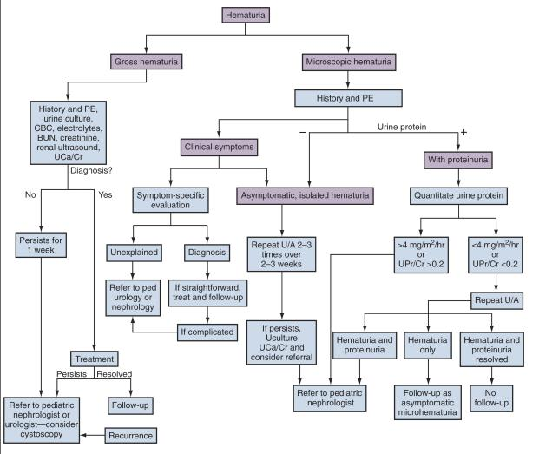
Algorithm for the treatment of hematuria

Slide 26
Further test and Follow
UA : repeated twice within 2weeks after initial specimen
Renal sono: screening test
noninvasive, stone, tumor, hydronephosis,
renal dysplasia, bladder, PUV
the value of normal finding: of normal -resssurance
IVP: macroscopic hematuria
aSx child with persistent morcoscopic hematuria normal creatinine, HT(-), proteinuria(-), RBC cast(-) ; no further investigation
Every 12 month: UA, proteinuria, blood pressure

Slide 27
Thank You!

